Slide 1
BS6200 Final Project
DengAI: Predicting Disease Spread
Zhang Chenxi
Notes:
Hello everyone, my name is Zhang Chenxi, now I will introduce the progress of my final project. My project is also the DrivenData competition, to predict dengue fever cases.

Slide 2


Introduction
Notes:
Let’s see some introduction first. Dengue fever is a mosquito-borne tropical disease caused by the dengue virus. Symptoms typically begin 3 to 14 days after infection. These may include a high fever, headache, vomiting, muscle and joint pains, and a characteristic skin rash.

Slide 3
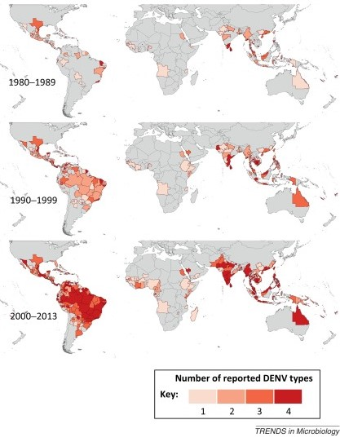
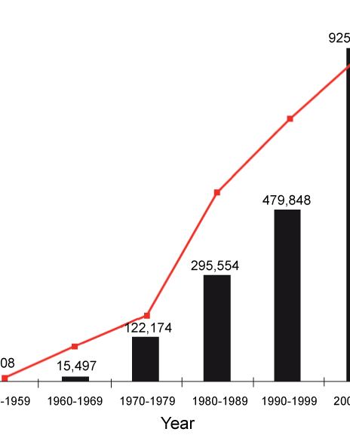
Notes:
The earliest descriptions of an outbreak date from 1779. Its viral cause and spread were understood by the early 20th century. Dengue has become a global problem since World War II, and the reported had increased significantly worldwide. In 2019, a significant increase in the number of cases was seen.

Slide 4
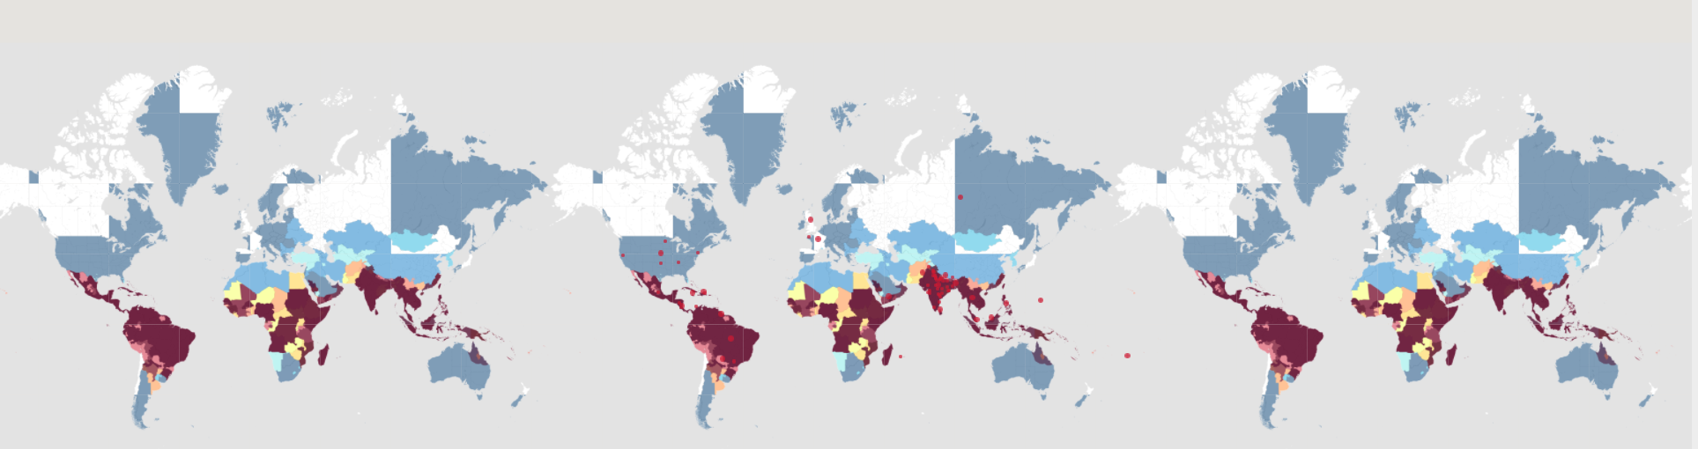
Introduction
Notes:
It is common in more than 120 countries, mainly in Southeast Asia, South Asia, and South America. About 390 million people are infected a year, about half a million require hospital admission, and approximately 40 thousand die. Apart from eliminating the mosquitos, work is ongoing for medication targeted directly at the virus. It is classified as a series tropical disease.

Slide 5

Introduction
Notes:
Well, since it is carried by mosquitoes, the transmission dynamics of dengue are related to climate variables such as temperature and precipitation. Although the relationship to climate is complex, a growing number of scientists argue that climate change is likely to produce distributional shifts that will have significant public health implications worldwide. Thus, an understanding of the relationship between climate and dengue dynamics can improve research initiatives and resource allocation to help fight life-threatening pandemics.

Slide 6
Data – City & Date
Name | Explanation
city | the City abbreviations (sj or iq)
year | year when the case was recorded
week__of_year | Detail datetime when the case was recorded
Notes:
The goal of my project is to predict the number of dengue fever cases reported each week in San Juan and Iquitos. The competition host provided 3 datasets, which include the dengue train feature set, the dengue train label set, and the dengue feature test set. All of the sets are scaled and ordered in chronological order. The feature set can be separated into 5 parts.
The first part is City and date indicators, where “city” represents the City abbreviations, such as sj for San Juan and iq for Iquitos, and the “year” and “week_start_date” represents the time when the case was recorded.

Slide 7
Data – Daily Climate Change
Name | Explanation
station_max_temp_c | Maximum temperature
station_min_temp_c | Minimum temperature
station_avg_temp_c | Average temperature
station_precip_mm | Total precipitation in millimeters
station_diur_temp_rng_c | Diurnal temperature range
Notes:
The second part is daily climate data measured by the weather station, which includes the Maximum temperature, the Minimum temperature, the Average temperature, the Total precipitation in millimeters, and the Diurnal temperature range.

Slide 8
Data – Reanalysis Climate
Name | Explanation
reanalysis_sat_precip_amt_mm | Total precipitation
reanalysis_dew_point_temp_k | Mean dew point temperature
reanalysis_air_temp_k | Mean air temperature
reanalysis_relative_humidity_percent | Mean relative humidity
reanalysis_specific_humidity_g_per_kg | Mean specific humidity
reanalysis_precip_amt_kg_per_m2 | Total precipitation
reanalysis_max_air_temp_k | Maximum air temperature
reanalysis_min_air_temp_k | Minimum air temperature
reanalysis_avg_temp_k | Average air temperature
reanalysis_tdtr_k | Diurnal temperature range
Notes:
The third part is the Climate Forecast System Reanalysis measurements, similar to the second part, but the climate forecast mainly focuses on air temperature and humidity. This part includes the Total precipitation in millimeters, the Mean dew point temperature, the Mean air temperature, the Mean relative humidity, the Mean specific humidity the Total precipitation in kilogram per square meter, the Maximum air temperature, the Minimum air temperature, the average air temperature, and also, the Diurnal temperature range.

Slide 9
Data – Normalized Difference Vegetation Index
Name | Explanation
ndvi_se | Pixel southeast of city centroid
ndvi_sw | Pixel southwest of city centroid
ndvi_ne | Pixel northeast of city centroid
ndvi_nw | Pixel northwest of city centroid
Notes:
The fourth part is the Normalized difference vegetation index, which is a simple graphical indicator that can be used to analyze remote sensing measurements, often from a space platform, assessing whether or not the target being observed contains live green vegetation. This feature set includes the pixel of southeast, southwest, northeast, and northwest of the city centroid.
In addition, the dataset also includes the Total precipitation amount in millimeters measured by satellite precipitation.

Slide 10
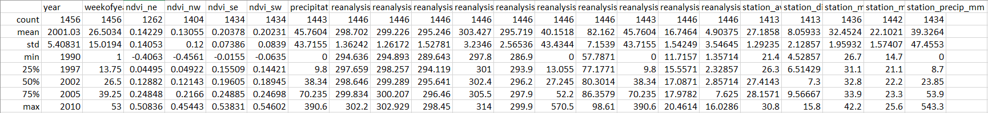
Data
Notes:
Here is a sample and a summary of the feature dataset. We can see that besides “city” and “year”, “week_start_date”, which are categorical and time ordinal data, all other variables are continuous variables.

Slide 11
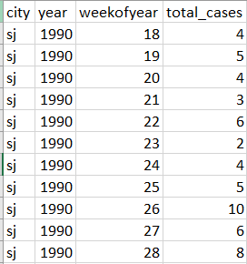
Data
Notes:
The label datasets include the reported total cases of a given city, year, and “Weekofyear”. This project will use various machine learning techniques, specifically, regression models, to predict the total cases based on the feature set. The goal is the minimize the mean absolute error between the predicted result and the actual result.

Slide 12
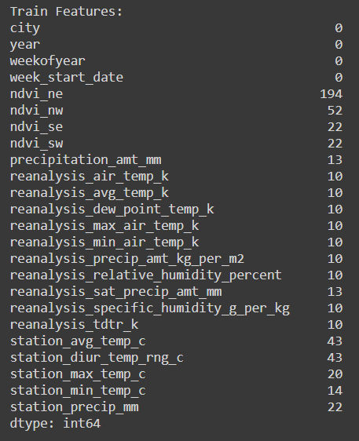
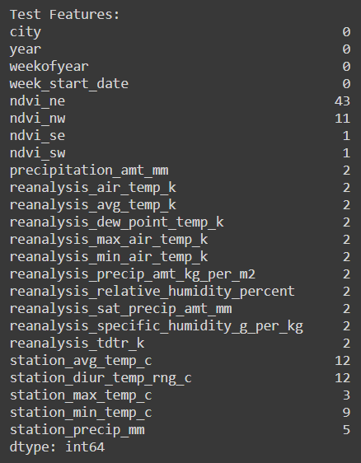
Data Exploration
Notes:
My first step is to explore and observe the dataset. Since the datasets include the features of two cities, I decide to separate them and do analyses on each one. To begin with, I checked the number of missing data within the feature set. As we can see, besides the city and date parameters, all other features have missing data. Since they are continuous variables, thus filling them manually is not an option; and the proportion of missing values is quite big, thus ignoring them is not a good choice as well.

Slide 13
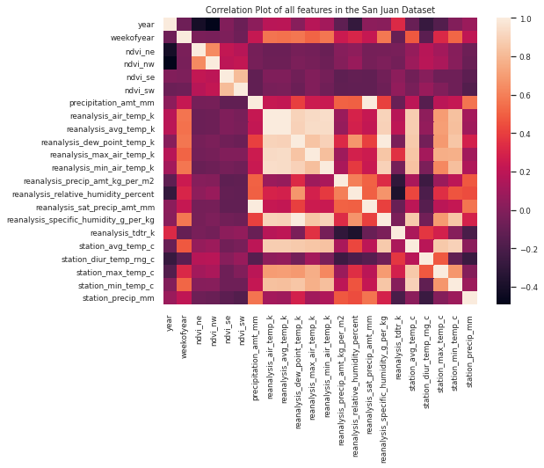
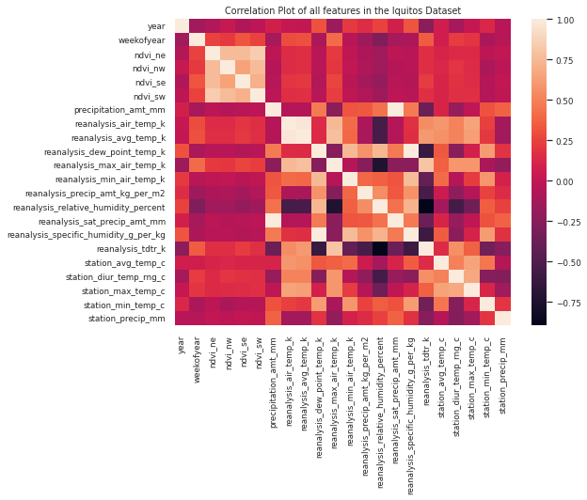
Data Exploration
Notes:
In the remaining options, I checked the correlation between each variable. As we can see from the heatmap, we can observe there exists some high correlations between several features, also, it is reasonable to believe that some variables are related to each other, such as the Maximum air temperature, the Minimum air temperature, the average air temperature. Thus instead of filling the missing values with column mean, I decide to use linear regression to interpolate the missing values. In addition to this, it is good to remove high correlated features in supervised learning, thus I decided to drop the terms that correlate greater than 0.95 or smaller than -0.95.

Slide 14
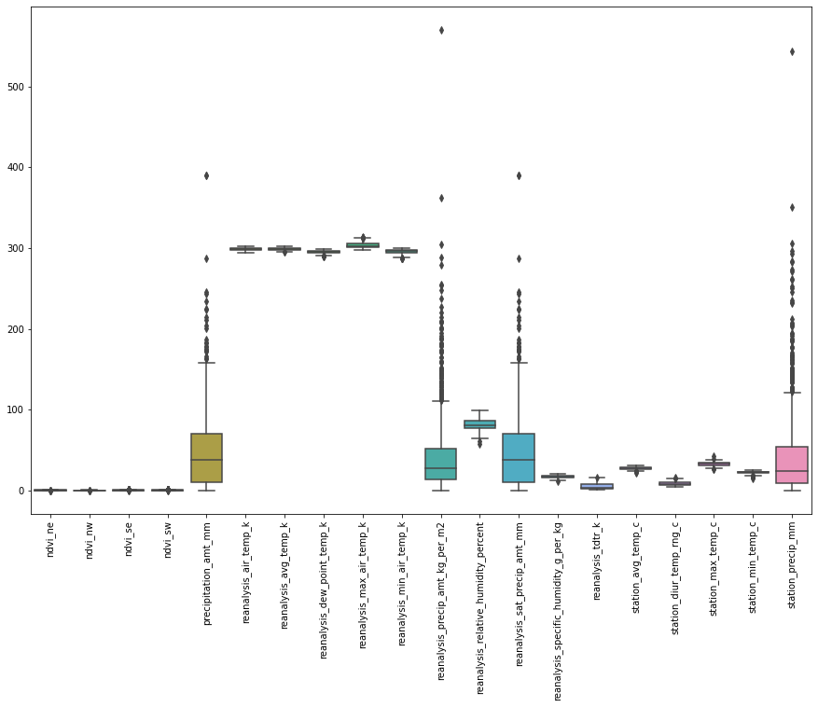
Data Exploration
Outliers from Climate Forecast System Reanalysis measurements
Convert Kalvin degrees to Celsius degrees
Use Z-score normalization for centering and scaling
Notes:
After that, I plotted the boxplot in order to observe the distribution as well as the outliers of each feature. I decided to ignore the ‘year’, ‘Week_start_date’, and ‘Weekofyear’ for now and judge solely on the continuous features. From the boxplots, we indeed can see most of the data points from the features from the Climate Forecast System Reanalysis measurements are deviate from their quantiles, which are outliers. First of all, I noticed some temperatures’ features are measured in Kalvin and some are measured in celsius. So I converted all Kalvin degrees to Celsius degrees. Then to Center and scale, I applied Z-score normalization to the feature sets by removing the mean and scaling to unit variance.

Slide 15
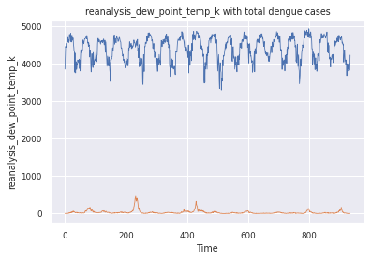
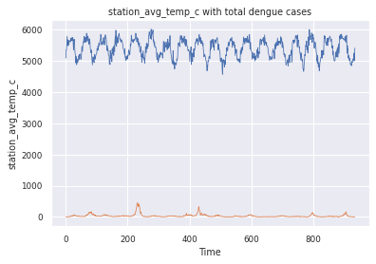
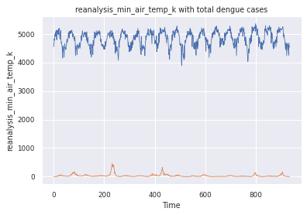
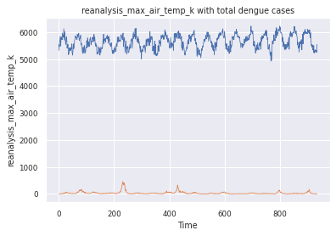
Data Exploration
Notes:
The shape of the feature set is 1456 by 24. Currently, the dimension is not very huge, thus it is not necessary to perform dimension reduction such as PCA. As for feature selection, I decided to bring back the time variable to see the hidden periodic trend of each feature. Rather than choosing only the features which are highly correlated with the total number of cases, I plotted the seasonal decompose graphs for each feature value including total cases. The are too many graphs, I will just show the elected ones. The selected plots are the features that shown a significant periodic pattern in time. One such pattern we can see that features like dew point temperature, specific humidity, min/max/average temperature peak every 52 weeks or around 52 weeks are similar to the total number of cases in San Juan.

Slide 16
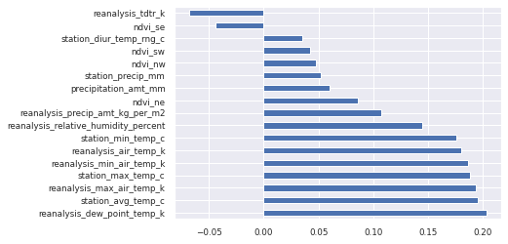
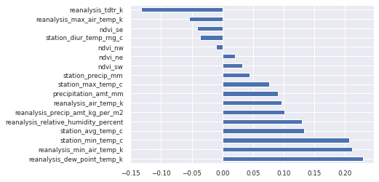
Data Exploration
Notes:
In addition, I also plot the correlation of each feature in ascending order. After cross compare the correlation with the periodic pattern, for San Juan, I decided to keep 'reanalysis_dew_point_temp_k', 'station_avg_temp_c', 'reanalysis_max_air_temp_k', 'station_max_temp_c', 'reanalysis_min_air_temp_k', and 'reanalysis_air_temp_k'; similarly, I decided to keep 'reanalysis_dew_point_temp_k', 'station_min_temp_c', and 'reanalysis_min_air_temp_k’. The difference between mine feature selection and siqi’s is that I didn’t include features like ‘reanalysis_specific_humidity_g_per_kg’, due to the reason it has been dropped previously since it has a correlation greater than 0.95.

Slide 17
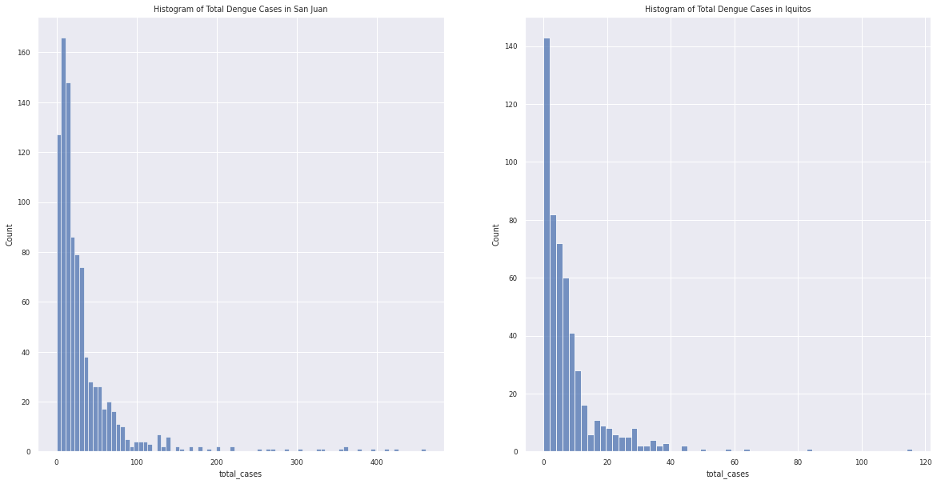
Data Exploration
Notes:
What’s more, I also plot the histogram of the total cases in order to see the distribution of the target. From the plot, we can see that the distribution is skewed to the right. The shape is very similar to the Poisson distribution and negative binomial distribution model.

Slide 18
Candidate Models
Linear Regression (Benchmark)
Poisson Regression
Negative Binomial Regression
Random Forest Regression with weights assigning
Notes:
As a result, my candidate models include negative binomial regression and Poisson regression model with the selected features, with linear regression as the benchmark. In addition, I also include Random Forest Regression to observe the mode ensemble result. Unlike the regular Random Forst, I assigned a weight to each feature based on their correlation to boost the result.

Slide 19
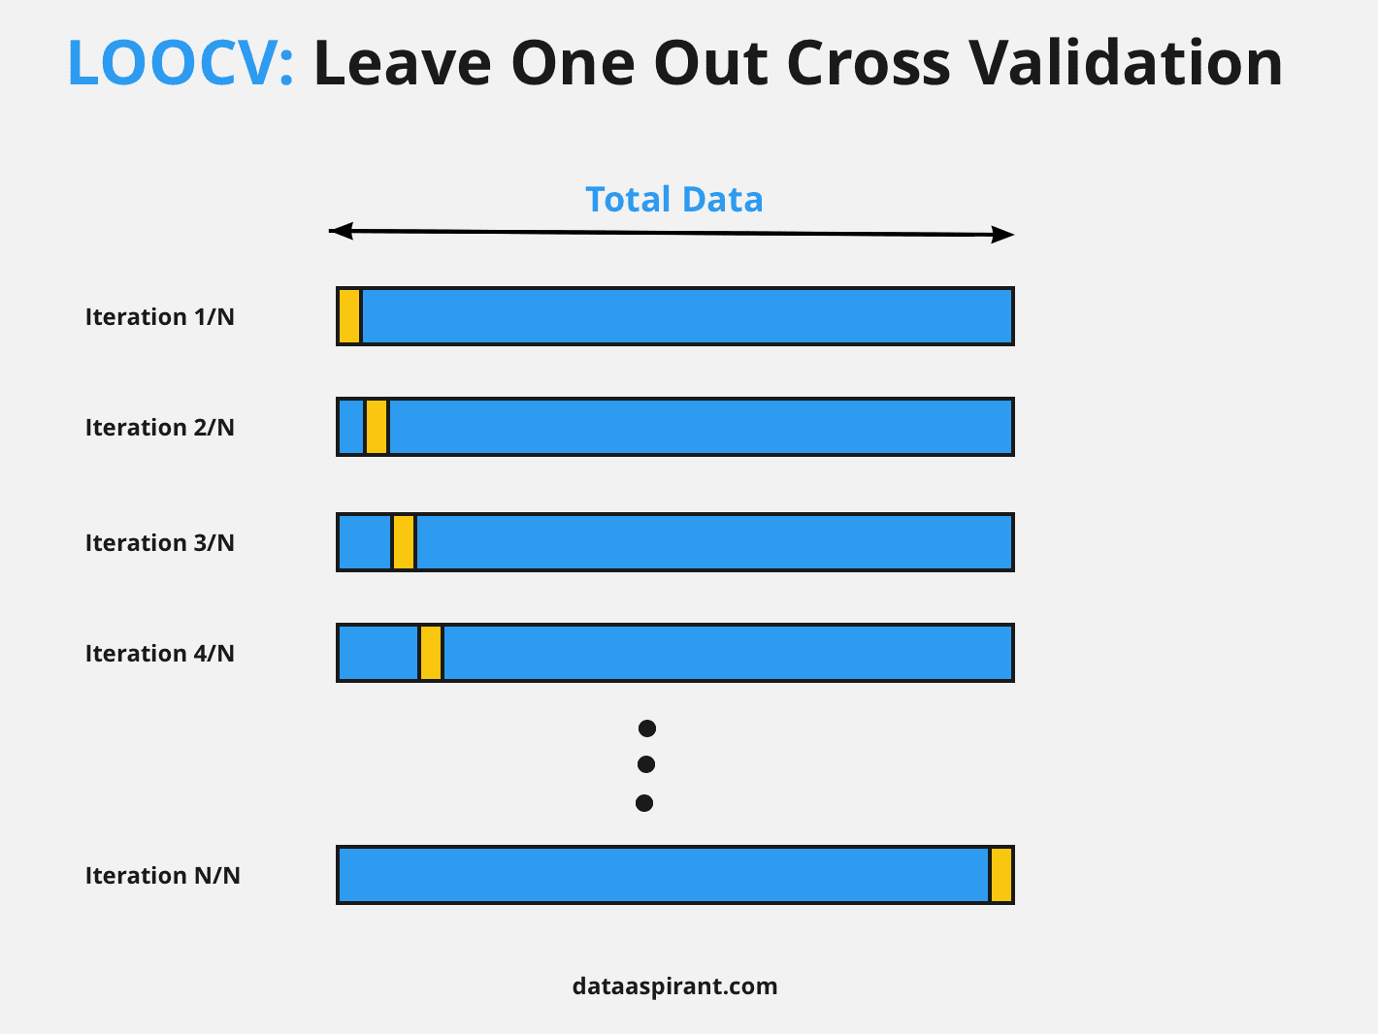
Leave-One-Out Cross Validation
Approximately unbiased
Computationally inexpensive
Good for calculation of MAE or MSE
Notes:
For evaluation, I split the dataset into the training set and test set randomly. And for the training set, I also split it into the training set and validation set. The technique I used is called leave-one-out cross-validation. Compare to k-fold cross-validation, Leave-one-out cross-validation is approximately unbiased, because the difference in size between the training set used in each fold and the entire dataset is only a single pattern. In addition, it is computationally inexpensive for models like regression, so it is suitable for imputations like MAE or MSE.

Slide 20
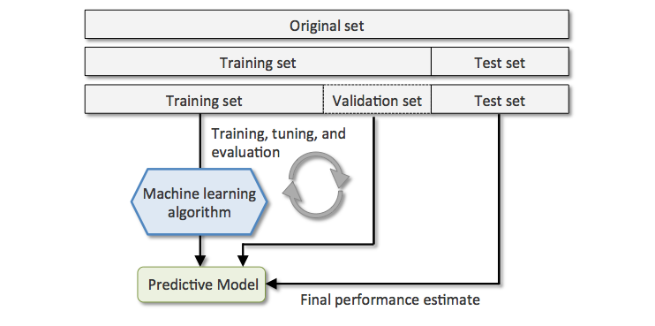
Training and Testing Procedure
Notes:
The overall Training and Testing Procedure is that: first I use each model to fit the training set and validation set, with cross-validation to find the best hyperparameter for the model which minimizes the mean absolute error. Then I apply the model to the test set to see the test MAE and use it to compare with other models.

Slide 21
Validation Results
 | San Juan | Iquito
Linear Regression | 24.88 | 7.04
Poisson Regression | 24.77 | 7.05
Negative Binomial Regression | 24.76 | 6.98
Random Forest Regression with weights assigning | 23.19 | 7.64
Notes:
The validation results are listed here. As we can see, the benchmark Linear Regression was able to reach a mean absolute error of 24.88 for San Juan and 7.04 for Iquitos. The Poisson Regression was able to reach a mean absolute error of 24.77 for San Juan and 7.05 for Iquitos, surprisingly, didn’t improve a lot compare to linear regression. The Negative Binomial Regression was able to reach a mean absolute error of 24.76 for San Juan and 6.98 for Iquitos, which appears to be the best model among the regression models. On the other hand, the machine learning Random Forest Regression model was able to reach a mean absolute error of 23.19 for San Juan and 7.64 for Iquitos, which ranks the best among all models.

Slide 22
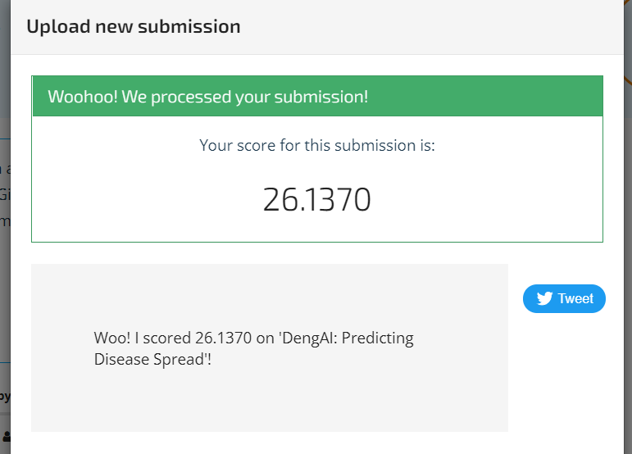
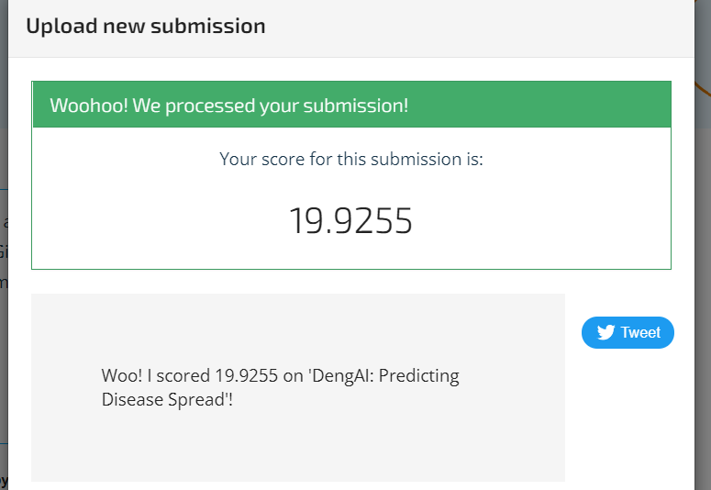
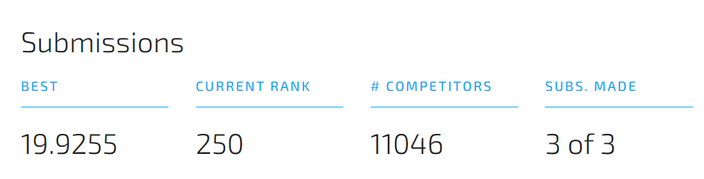
Test Results & Achievement
Notes:
After that, I used the Negative Binomial Regression and Random Forest Regression to produce the submission file with the actual test file and submitted them into the competition cite. Surprisingly, the Negative Binomial Regression’s mean absolute error increased 26.137, however, this still allows me to rank 286th place among 11046 competitors; the Random Forest Regression with weight assigning was able to reach a mean absolute error of 19.93, which boost my rank from 286 to 250.

Slide 23
Analysis
Negative Binomial Regression Overfitting
Relationship between features and cases may be non-linear
Correlation between selected features are unclear
Notes:
Based on the performance of the Negative Binomial Regression, it is obvious to conclude that those regression models are overfitting the datasets. One possible reason might be that the correlation between each individual feature and the total_cases was less. Therefore the relationship between those features and total_cases may be non-linear. Another possible reason might be the correlation between selected features since they are unclear.

Slide 24
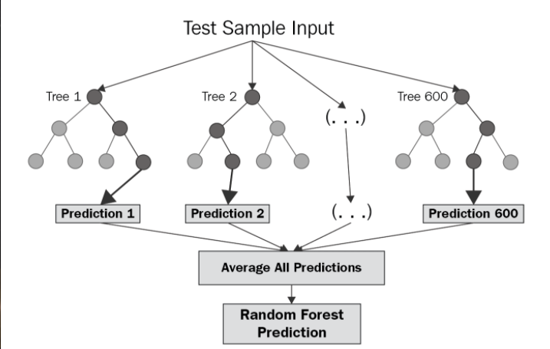
Analysis
Notes:
This may also be the reason why Random Forest Regression models perform ahead of other models due to the ability to learn non-linear relationships and robustness to outliers since it uses multiple models to obtain better predictive performance by using ensembling methods and cross-validation to select the best number of trees.

Slide 25
Summary
Fill in missing values with linear interpolation and used z-score normalization
Cross compare seasonal-pattern and correlation for feature selection
Achieved MAE 19.93 and ranked 250th place at the competition
Notes:
To sum up, I first fill the missing values with linear interpolation and applied z-score normalization in the preprocessing step. When it comes to feature selection, I first analyzed the correlation matrix containing correlation between each feature and remove the high correlated ones, and then I cross-compare with the correlation between features and the total cases and feature’s seasonal decompose to select features with high correlation and significant seasonal periodic patterns. For Random Forest Regression, I also added weights to each feature. In the end, I was able to achieve MAE 19.93 and reached the top 25th quantile of the competition.

Slide 26
Future Work
Use “Weekofyear” feature
Use seasonal-decompose, predict seasonal cases, then total cases
Notes:
However, I did not use the weekofyear feature in this project, by observation, there should be a connection between this variable and the total cases. I believe one of the possible approaches is to use weekofyear to predict the seasonal cases first, then use the seasonal cases to predict the total cases.

Slide 27

Thank you
Notes:
This is all for my project. Before I end my presentation, I would like to remind everyone that Singapore is high risk location for dengue fever, so it is important to stay healthy, and watch out for mosquito bites. Thank you so much for listening my presentation. Feel free to ask any questions.

